Slide 1



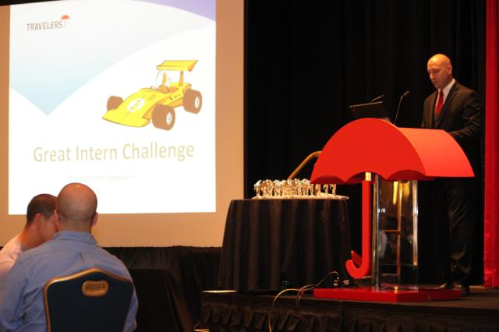
BI&A LDP Analytics Case Competition
Business Insights & Analytics Leadership Development Program

Slide 2


Business Insights & Analytics Leadership Development Program
Agenda
Welcome and Introductions
Insurance Overview
Travelers’ Overview
Travelers’ Culture
Business Intelligence & Business Insights
BI&A LDP Overview
Internship
Full-time
How to Apply
Q & A
© 2023 The Travelers Indemnity Company. All rights reserved.

Slide 3
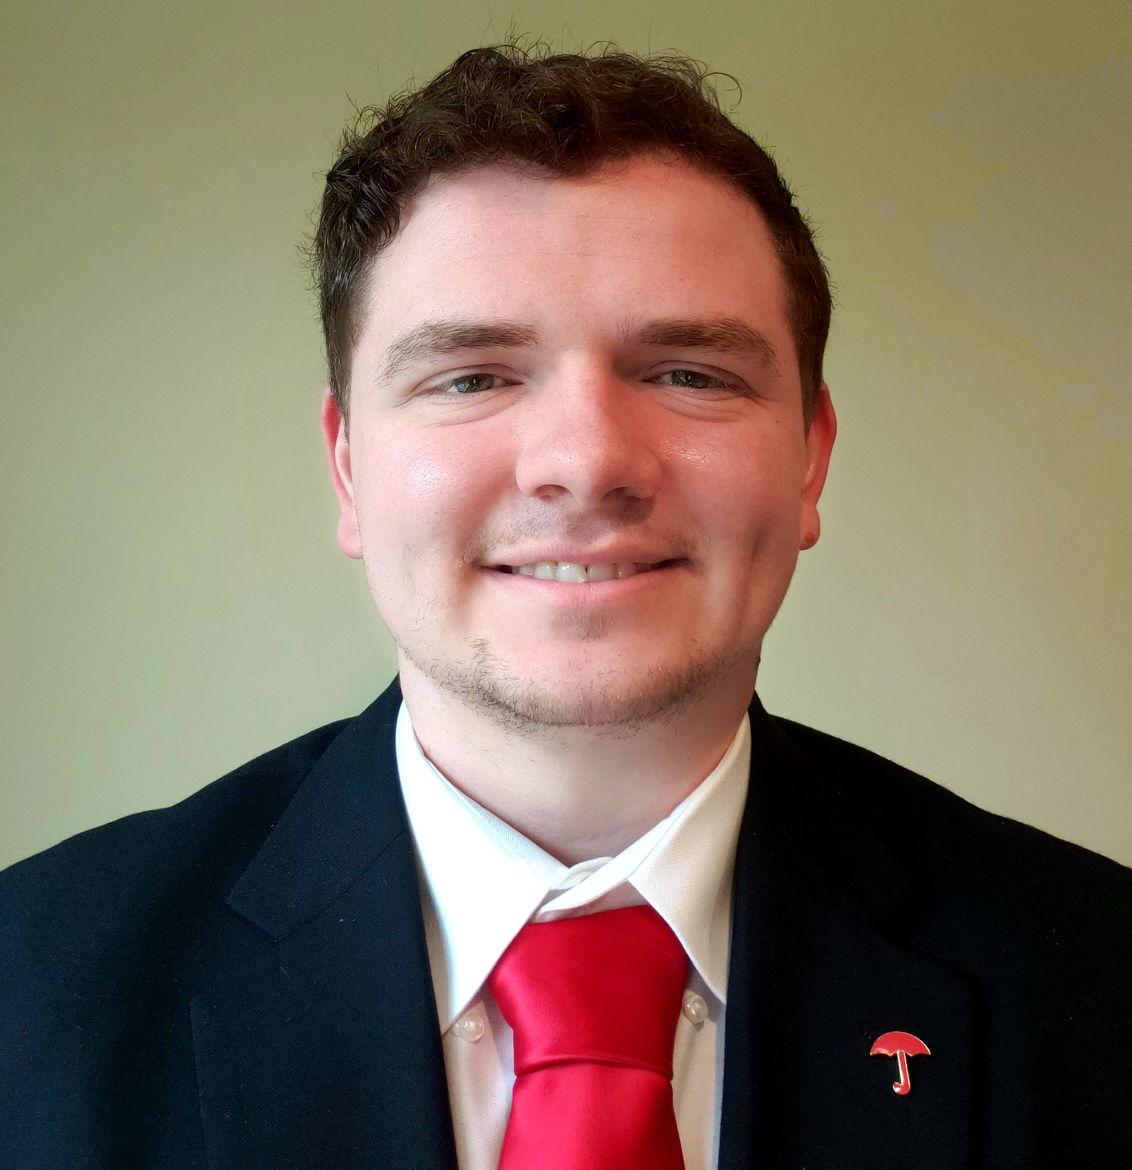

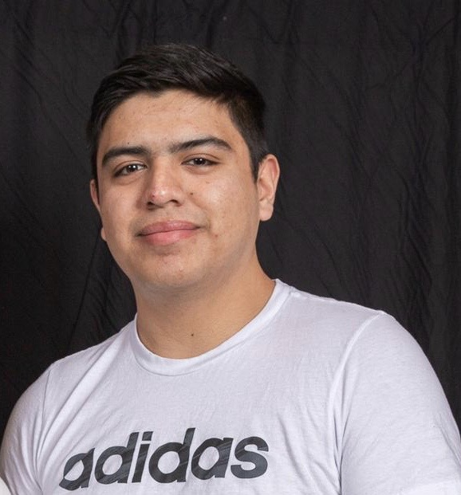
Introductions
McCullah Lamp
3rd Rotation BI&A LDP
Data Engineering Consultant
Claim Business Intelligence & Analytics
Julia Tremblay
2nd Rotation BI&A LDP
Information Delivery Consultant
Personal Insurance
Jafet Aparicio
2nd Rotation BI&A LDP
Data Engineering Consultant
Claim Business Intelligence & Analytics
© 2023 The Travelers Indemnity Company. All rights reserved.

Slide 4
Why Travelers?

Slide 5
2022-2023 Opportunities
Why Insurance?
It’s Limitless
It’s Stable
It’s Generous
Careers range from Actuaries to Accountants, Data Scientists to Computer Technologists, Finance Analysts to Fire Investigators, Product Managers to Programmers, Underwriters to Statisticians just to name a few.
As of August 2022, the Bureau of Labor Statistics unemployment rate for the insurance industry is 1.7%, which is 2% lower than the national average of 3.7%.
Donates millions of dollars a year to charitable organizations and thousands of volunteer service hours according to mypath.org
a collaborative industry effort tasked with educating students about the industry.
© 2023 The Travelers Indemnity Company. All rights reserved.

Slide 6








The Travelers Companies, Inc.
1864
First introduced accident insurance stateside for two cents
1919
First offered aircraft liability insurance, with a full aviation program
1969
First issued accident policies for space flight and lunar exploration
2019
Announced the Travelers Paying it Forward Savings Program, helping employees save for retirement while tackling student debt
1897
First issued an automobile insurance policy
1968
First pioneered the “CAT Van”, a specially modified RV used as a mobile claim office to assist policyholders after disasters
2016
Created the first Early Severity Predictor, the first predictive model to help injured employees avoid chronic pain and opioid use
2019+
Investing in machine learning, artificial intelligence, and straight through processing
© 2023 The Travelers Indemnity Company. All rights reserved.

Slide 7
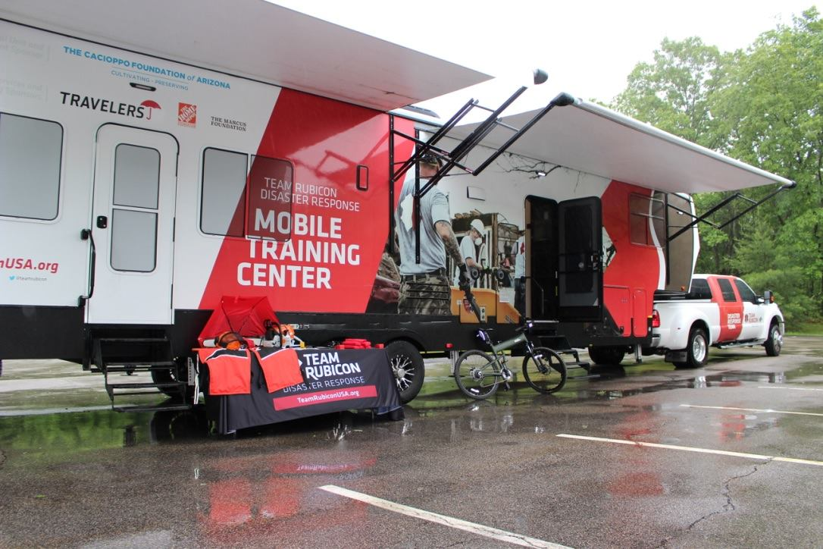
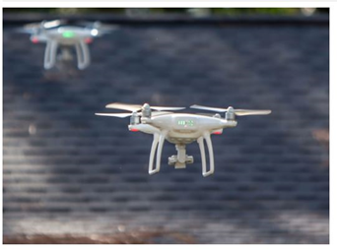

2022-2023 Opportunities
Innovation Initiatives
Team Rubicon
Travelers provided $1ml in grant funding in 2021 for Team Rubicon’s low-attention disaster rebuild program, a new disaster response outreach effort. Team Rubicon, a non-profit organization, unites the skills and experiences of military veterans with first responders to rapidly deploy emergency response teams after disasters, all while providing veterans with a new sense of purpose, community and identity.
Drone Training Program
Claim professionals access hands-on training on how to operate drones and become FAA certified drone pilots. The program has trained hundreds of drone operators. This technology is used to assess damage from Hurricanes or other disaster areas more safely and expeditiously.
Autonomous Vehicle Insurance Framework
The Travelers Institute, the public policy division of Travelers, released a position paper in 2021 “Insuring Autonomy: How auto insurance will lead through changing risks.” Travelers has been a longtime leader and innovator in both personal and commercial auto insurance and supports the creation of a coalition of non-government stakeholders to make recommendations on insurance-related autonomous vehicle issues.
© 2023 The Travelers Indemnity Company. All rights reserved.

Slide 8



2022-2023 Opportunities
Office Locations
Hartford, Conn.
Hartford is our largest location housing over 7,000 employees responsible for a variety of functions across all lines of business. It is commonly referred to as the “Insurance Capital of the World.”
St. Paul, Minn.
St. Paul is our second largest location housing more than 2,000 employees responsible for a variety of functions across all lines of business. It is one of the “Twin Cities” along with Minneapolis.
Field Offices
With a focus on Underwriting, Marketing/Sales and/or Claim and Risk Control, these offices are located throughout all regions of the U.S., including but not limited to:
Alpharetta, Braintree, Buffalo, Charlotte, Dallas, Denver, Houston, Hunt Valley, Knoxville, Naperville, Nashville, Northern & Central NJ, NYC & Long Island, NorCal, Orlando, Philadelphia, Phoenix, Portland, Richmond, St. Louis, San Antonio, Spokane, etc.
© 2023 The Travelers Indemnity Company. All rights reserved.

Slide 9
Travelers’ Culture

Slide 10
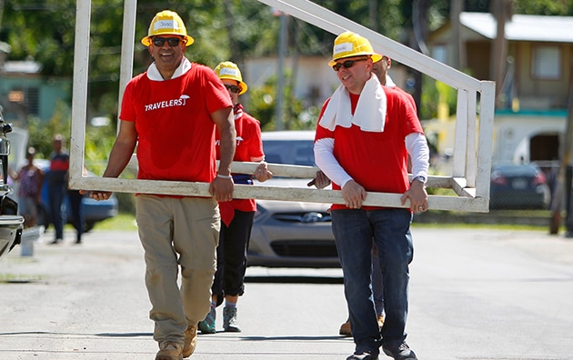


The Travelers Promise
Every day we go to work, we are committed to helping to take care of our customers, our communities and each other
Our Communities
We actively support academic and career success, and promote the development of thriving neighborhoods and enriched communities.
Our Customers
We work to help our customers recover after a loss so they can get back to focusing on their families and businesses.
Each Other
We’re a talent destination for the best in the industry, an enjoyable work place for our diverse workforce and a caring partner to our agents and brokers.
© 2023 The Travelers Indemnity Company. All rights reserved.

Slide 11
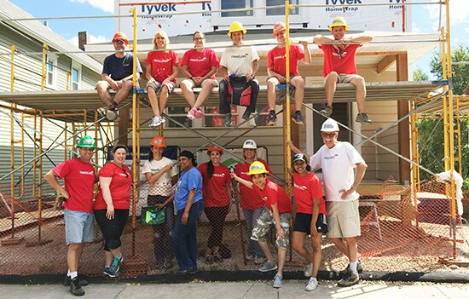
2022-2023 Opportunities
In the Community
$22 million annual average overall charitable giving
The Travelers Championship has generated over $25 million dollars since 2007 supporting local CT charities.
Giving priorities:
Academic and Career Success
EDGE Program - Scholarships
Thriving Neighborhoods
Habitat for Humanity
Culturally enriched communities
Travelers Art Speaks
Matching Gifts and Volunteer Grants Programs
57,000 volunteer hours reported in 2021.
LearnMoreAboutCommunity
© 2023 The Travelers Indemnity Company. All rights reserved.

Slide 12





2022-2023 Opportunities
Our Diversity Networks include:
Asian & Allies Diversity Network
Black/African American & Allies Diversity Network
disAbility & Allies Diversity Network
Hispanic/Latino & Allies Diversity Network
Pride & Allies Diversity Network
Military and Veterans & Allies Diversity Network
Women & Allies Diversity Network
Young Professionals & Allies Diversity Network
© 2023 The Travelers Indemnity Company. All rights reserved.

Slide 13
Business Intelligence & Business Insights

Slide 14





WHAT IS BUSINESS INTELLIGENCE?
AT ITS CORE, BUSINESS INTELLIGENCE IS ABOUT…
Improving outcomes with better decision-making…
…providing the right information in the right hands at the right time in the
right way.
Business Acumen
+
Data & Analytics
by blending art and science
© 2023 The Travelers Indemnity Company. All rights reserved.

Slide 15
BUSINESS INSIGHTS
TURNING BUSINESS INTELLIGENCE & ANALYTICS INTO BUSINESS INSIGHTS
Business Acumen
+
Data & Analytics
BUSINESS CUSTOMER NEEDS, GAPS, & ASKS
BUSINESS INSIGHTS
© 2023 The Travelers Indemnity Company. All rights reserved.

Slide 16
BI&A LDP Overview

Slide 17
Internship program

Slide 18






BI&A LDP Internship Specifics
Gain first-hand business experience within the BI&A community.
Attend technical training workshops, speaker series, and engagement functions.
Networking and mentorship opportunities with senior leaders, current & former BI&A LDP participants, and other students.
Ownership in meaningful day-to-day responsibilities and being able to make a difference.
Opportunity to apply to the full-time rotational program.
Technical Training: Excel, SQL, Python, SAS, Dashboarding, Cloud/AWS, GitHub, Datalog
Industry Discussions:
BI&A LDP Executive Sponsors & Operating Committee Panels
Emerging Trends Discussion Series: Cloud & MaaS 2.0, Geospatial & Imagery
Fun & Engagement: Intern HUDDLES & Intern Olympics
© 2023 The Travelers Indemnity Company. All rights reserved.

Slide 19
Full time program

Slide 20
What to know about the BI&A LDP
Roles and Rotations
Length
A 3-year program with optional rotations and expanded curriculum and development.
BI&A LDP participants have a diverse range of insights and analytics skillsets, including tabular and spatial analysis, data engineering, information delivery, and business communication.
Participants can expand their skills through optional rotations. This develops diverse talent to fill a broad collection of roles across Business Insights, Analytics, and Technology in the following job families:
As part of the BIALDP, participants have access to a balanced and tailored curriculum involving technical and business training that they can apply in their role.
Trainings
Cohort
As of September 2022, the program consists of a cohort of 103 participants and growing.
Onboarding & Engagement
Data Engineering
Business Analysis
Information Delivery
When you start with the BIALDP, you’ll have access to a peer advisor and mentors to guide you through your time in the program.
Peer Advisor: An informal advisor that was recently in a similar position to yours
Mentors: Leaders in the organization with experience to help you navigate your career
BI&A LDP participants have ample leadership and collaboration opportunities within the fulltime program, assisting with the BI&A LDP interns, and working with other LDPs.
You’ll also have the opportunity to network with leaders and peers through activities organized by our engagement committee.
Business Performance Analytics
Geospatial
Data Management
© 2023 The Travelers Indemnity Company. All rights reserved.

Slide 21


2023-24 Opportunities
Explore Travelers
Learn More
Apply Online!
Requisitions and Advice
Visit our Students and Graduates Page at travelers.com/studentsgrads for additional information and to join our Campus Talent Connection.
Check out Travelers Careers Social Media Pages:
Facebook.com/TravelersCareers
Twitter: @TRV_Careers
Instagram: @travelerscareers
Connect with Travelers on LinkedIn.
Read about us on Glassdoor.
Search for and apply to jobs at careers.travelers.com
Please note, if Travelers is hosting on-campus interviews at your school, you will have to apply through your Career Services portal in addition to the Travelers Careers site.
TBD
© 2023 The Travelers Indemnity Company. All rights reserved.

Slide 22
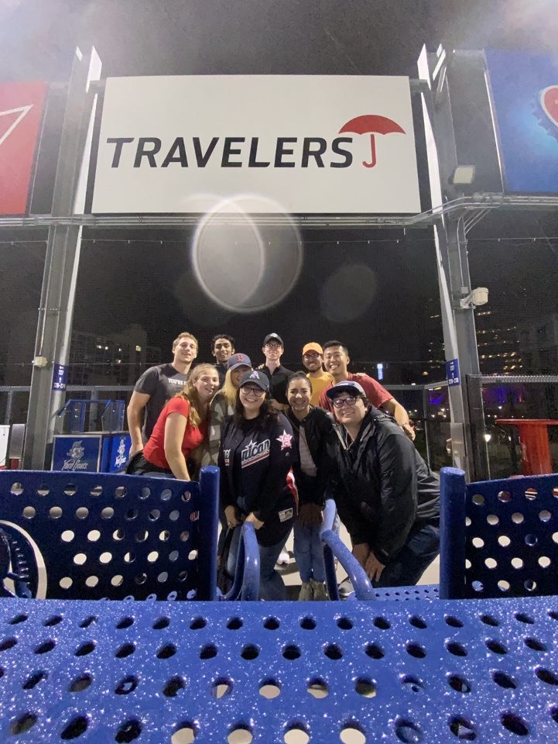
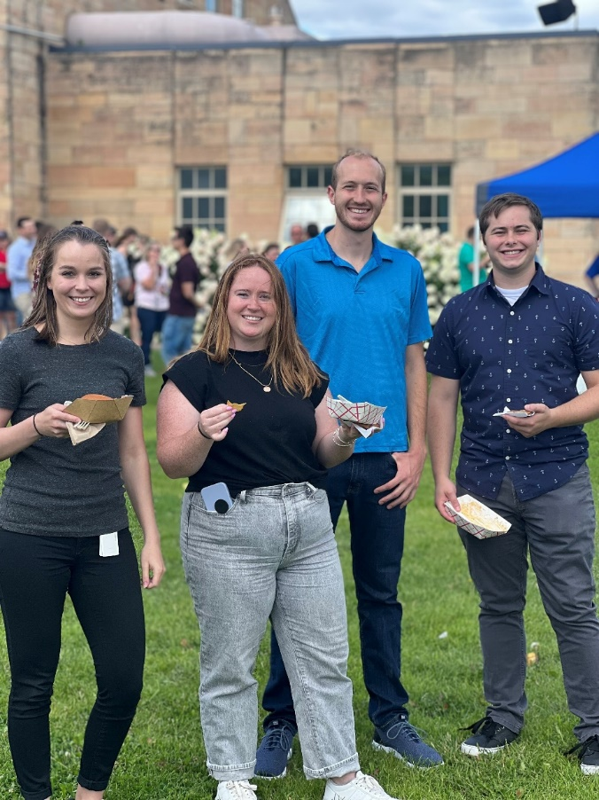
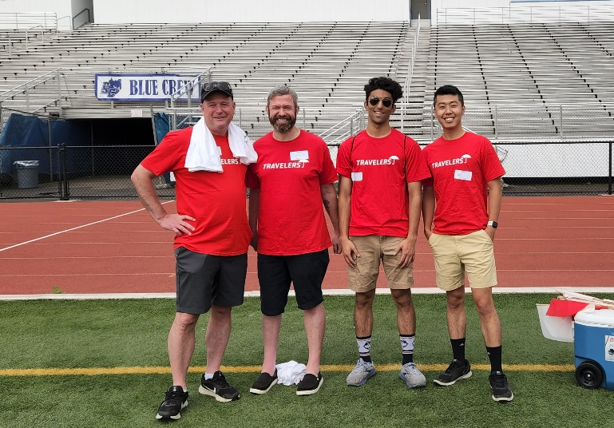
BI&A LDP Community
© 2023 The Travelers Indemnity Company. All rights reserved.

Slide 23
BI&A LDP Case Competition

Slide 24
Case Competition Format
Teams
A team is composed of 3 students
At least one member should be familiar with some analytical tool
Must be registered by the Feb.16th deadline
Presentations
Competition Guidelines
First Round
Where: On campus
Time: Presentations have a time limit of 15 minutes
1-2 minutes of setup
8 minutes to present
5-minute Q&A after presentation
Presentation: Must use Microsoft PowerPoint 2016 or newer
Judging Criteria: 4 categories
All resources found online or with other sources can be utilized, but must be referenced
Case solutions should not be discussed between teams as there is not a singular solution
Teams are encouraged to get feedback from faculty, staff, advisers, etc. however, all slides must only be created by members on that team
Second Round
Where: Travelers – Hartford, CT
Time: Presentations have a time limit of 20 minutes
1-2 minutes of setup
8 minutes to present
10-minute Q&A after presentation
Presentation: Must use Microsoft PowerPoint 2016 or newer
Judging Criteria: 4 categories
© 2023 The Travelers Indemnity Company. All rights reserved.

Slide 25
Project Timeline
Feb 15th
Kick off
Feb 17th
(12:00pm)
Competition Start
Feb. 27th
(11:59pm)
Withdrawal Deadline
Mar 3rd
1st Round
Presentations
Mar 9th
(11:59pm)
Presentation Submission
Feb 16th (11:59pm)
Registration Deadline
Feb 24th
(TBD)
Q&A Session
Mar. 2nd
(11:59pm)
Sign-Ups & Presentation Submission
Mar 6th
Presentation Feedback
Mar 10th
2nd Round Presentation
© 2023 The Travelers Indemnity Company. All rights reserved.

Slide 26
Suggestions for Software and Analytical Tools
Analytics Software
SQL
Python
Excel
Dashboarding/Reporting Software
Excel
Tableau
Qlik
MicroStrategy
© 2023 The Travelers Indemnity Company. All rights reserved.

Slide 27
Contact Information
Julia Tremblay - UConn
Jetrembl@travelers.com
McCullah Lamp - UConn
MLAMP@travelers.com
Jafet Aparicio – ECSU
JAPARICI@travelers.com
© 2023 The Travelers Indemnity Company. All rights reserved.

